Slide 1
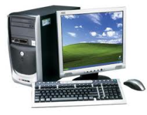
Computer Applications
Fall 2018
Notebook / MP1
NO LATE NOTEBOOKS WILL BE ACCEPTED
Class handouts 10% Parent/Student/Teacher, Syllabus, Electronic Device Policy, Computer Basics Roadmap, GMETRIX Codes, Project Presentation Rubric, Homework/Classwork Rubric
2. Classroom and homework assignments: 40% Sample Tests 1-5, library assignment, store visit form, “Is Your Electronic Device Harming You?”, computer system information
3. Projects: Computer Purchase, Computer Purchase Presentation
Jeopardy Game 30%
3. Test Scantrons: 10%
4. Did you hand in a notebook (separate, with sleeves) on time? 10%
Minus:
Is your name and period number clearly written on the cover? - 5% if missing
Is your notebook in good condition, organized well, and presented nicely? - 5% if notebook is not in presentable condition.
Grade

